Slide 1

Reviewing a Rating
Decision
DAVE HUNTIMER
Notes:
We are going to discuss the basics of reviewing a rating. We could do whole separate classes on the different topics such as reading an exam, VA Math in figuring out combined percentages, bilateral factors etc…..

Slide 2
Rating Definition
A rating is defined as a formal decision made by the VA based on available medical evidence.
In compensation cases, rating activity determines if the disability claim is service related or not.
If the rating is deemed service connected, a rating percentage would be assigned to that condition. A rating can be from 0% to 100%. To receive compensation, the veteran must be rated at least 10% disabled.
Multiple ratings will be combined into one overall rating.
Notes:
Always remember, a 0% is still a positive rating. Even though the veteran will not receive compensation now, they may in the future if the condition gets worse. Also, a 0% rating gets them care at the VA for that condition. A good example is hearing. Most hearing grants are at 0% but they now get their hearing aids and supplies from the VA for free.

Slide 3
Key Documents to Review
Rating Narrative. (Main Document)
Rating Code Sheet. (Main Document)
Notification Letter. (Main Document)
C&P Exams. (Secondary: Need VBMS Access)
Any Documents of Evidence submitted with Claim. (Secondary)
CFR to make sure appropriate percentage was assigned. (Secondary)
Original Claim Submitted: (21-526EZ, 20-0995 ETC…..)
Notes:
The first three documents are the Main documents to review and should be in VetraSpec.
C&P exams will be in VBMS. If you do not have VBMS Access, contact the Sioux Falls Office and ask them to look over the exam IF NEEDED.
You can use either the CFR Book or ECFR on line. If you use the book, make sure it is an up to date copy. The ECFR will be up to date.
Make sure that each item claimed was addressed.

Slide 4
Rating Narrative
General Information: VA office – Veteran name and file number – Represented by – Rating Decision Date.
Introduction: Service information.
Decision: Breakdown of what was claimed and what the grant is.
Evidence: Evidence that was considered to make the decision.
Reasons for Decision: Breakdown of how they made their decision and what would be needed for a different rating decision.
References: References used in making the decision.
Notes:
Rating Decision Narrative manual is in M21-1, Part III, Subpart iv, Chapter 6 Section C. The rating narrative is broken down into 6 areas.

Slide 5
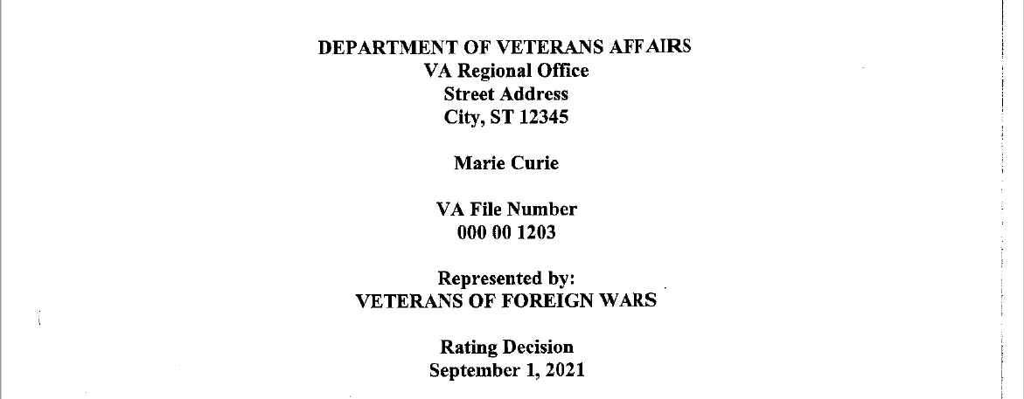
Rating Narrative-General Information
Notes:
Lets start at the top of the form and work down. First is the Office. Next the veterans name. Then the VA file number. Who is representing the veteran and then the Rating Decision Date. Remember, this is the decision date not the effective date.

Slide 6
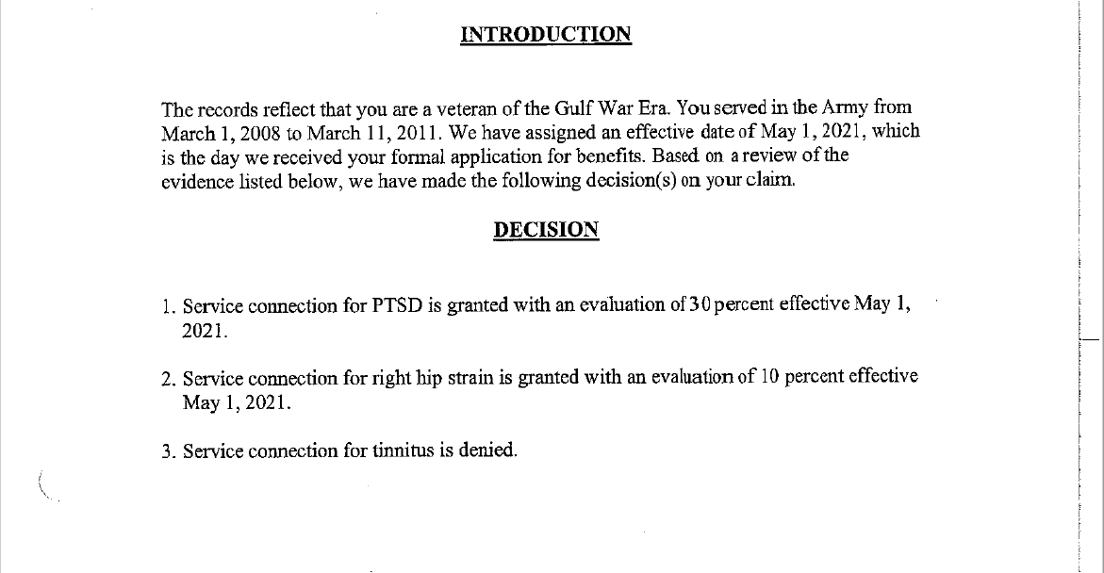
Rating Narrative-Introduction/Decision
Notes:
The introduction will cover the veteran’s era and service dates.
A Decision can be 1. Granted 2. Continued 3. Confirmed and Continued 4. Increased/Decreased 5. Denied. It will end with the effective date of that decision.

Slide 7
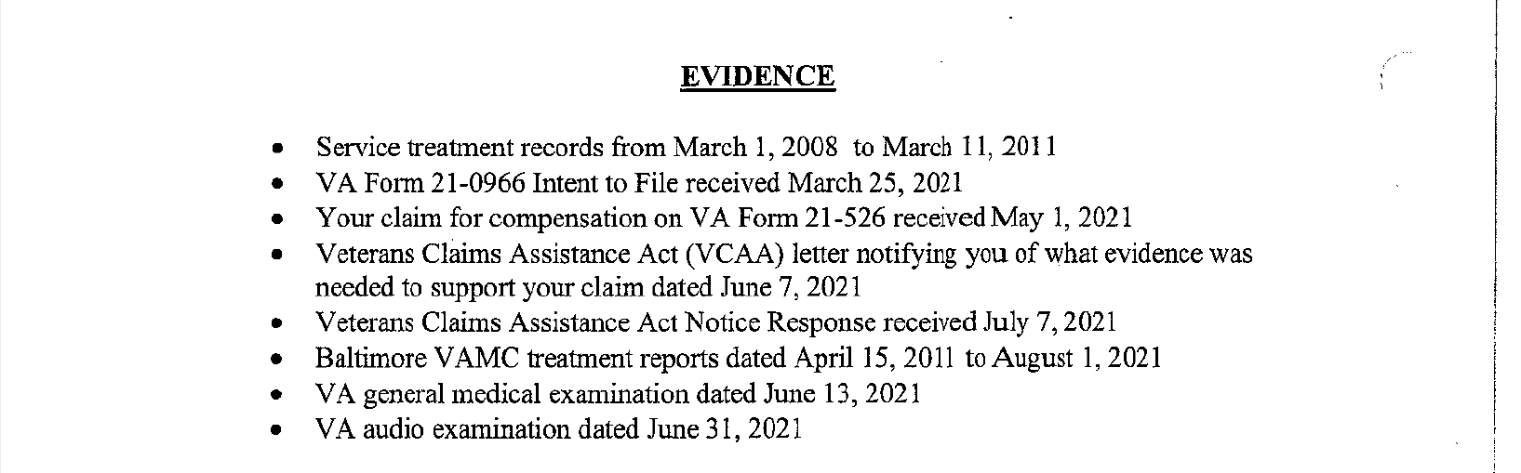
Rating Narrative-Evidence
Notes:
You will want to make sure all of the evidence you submitted is listed. If it is not, then you need to see where it got dropped. Did it get sent with the packet, Did it get uploaded in quick submit but did not hit VBMS or is it in VBMS and just got missed.

Slide 8
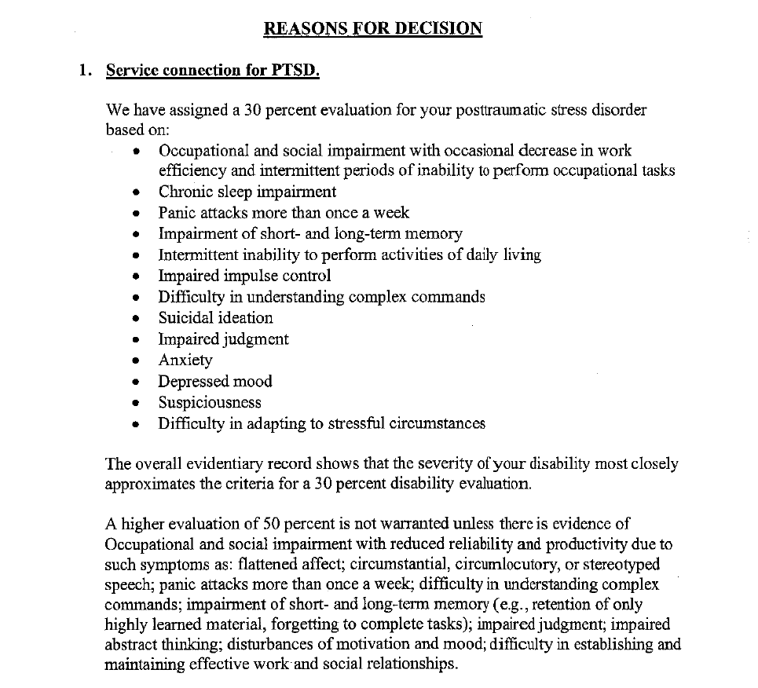
Rating Narrative-Reasons for Decision
Notes:
First paragraph is what was awarded and what it was based on.
Second paragraph is tells you what the decision most closely approximates.
Third paragraph tells you what would be needed to warrant the next higher rating. (Look at Panic Attacks 4th Line). They don’t need all of the list but like panic attacks. Has more than once a week, they may rate the next higher percentage.
PANIC ATTACKS MORE THAN ONCE A WEEK. If you look in the C&P exam and it says they have 4 panic attacks a week, there is an error.

Slide 9
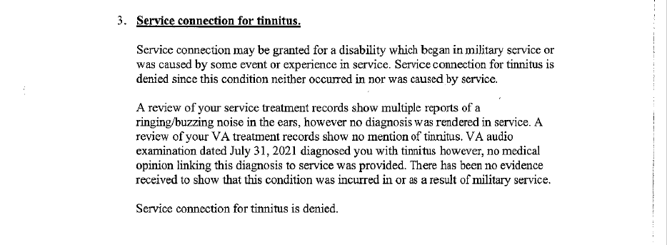
Rating Narrative-Reasons for Decision
Notes:
This is an example of a denial
It tells you why they denied it which will show you what you can use to appeal it or what evidence may be needed yet to get a positive decision. In this one, you need a medical opinion linking it to service. Look back at treatment records and see what there MOS was at the time they were in. Some MOS’s are conceded for hearing and tinnitus.
The 10-year protection rule (38 CFR 3.957) that service connection for any disability that has been in force for 10 or more years cannot be severed unless fraud is shown or if the veteran did not have the requisite service or character of discharge. It can be reduced.
The 20-year protection rule (38 CFR 3.951) states that after a veteran has held a rating at or above a specific level continuously for 20 years or more, the percentage assigned to that disability cannot be reduced unless fraud is proven.

Slide 10
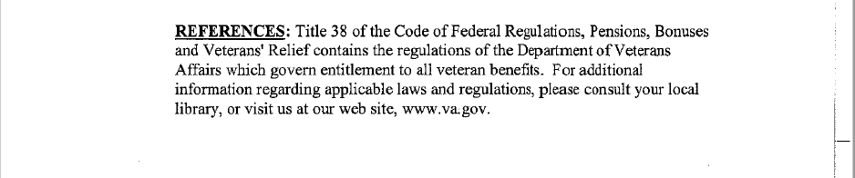
Rating Narrative-References
Notes:
Last is Reverences used: 38 CFR. Again, make sure you are using ECFR or a current hard copy.

Slide 11
Rating Code Sheet
General Information
Jurisdiction
Associated Claims
Subject to Compensation
Not Subject to Compensation
Combined Evaluation for Compensation
Notes:
Always remember that the Code Sheet is more of a snapshot and the Rating Narrative is where the breakdown of information is located.
Rating code sheet is broken down into 6 areas.

Slide 12
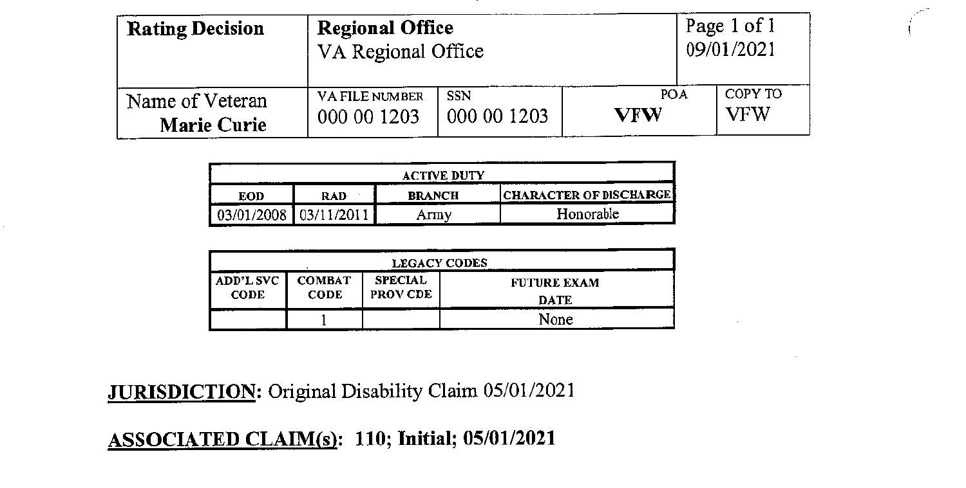
Rating Code Sheet
Notes:
The manual for the Rating Code Sheet is found in M21-1, Part III, Subpart iv, Chapter 6 Section D.
The top will start with Regional Office, how many pages follow then go into Veteran demographics. Next will be military information listing Entry date into active duty, release from active duty, branch and character of discharge.
Next will list any Legacy codes, then go into Jurisdiction and Associated Claims. Remember to look at Future Exam Dates. Some injuries by nature will heal and thus be set up for future exams to see if the rating percentage should be lowered.

Slide 13
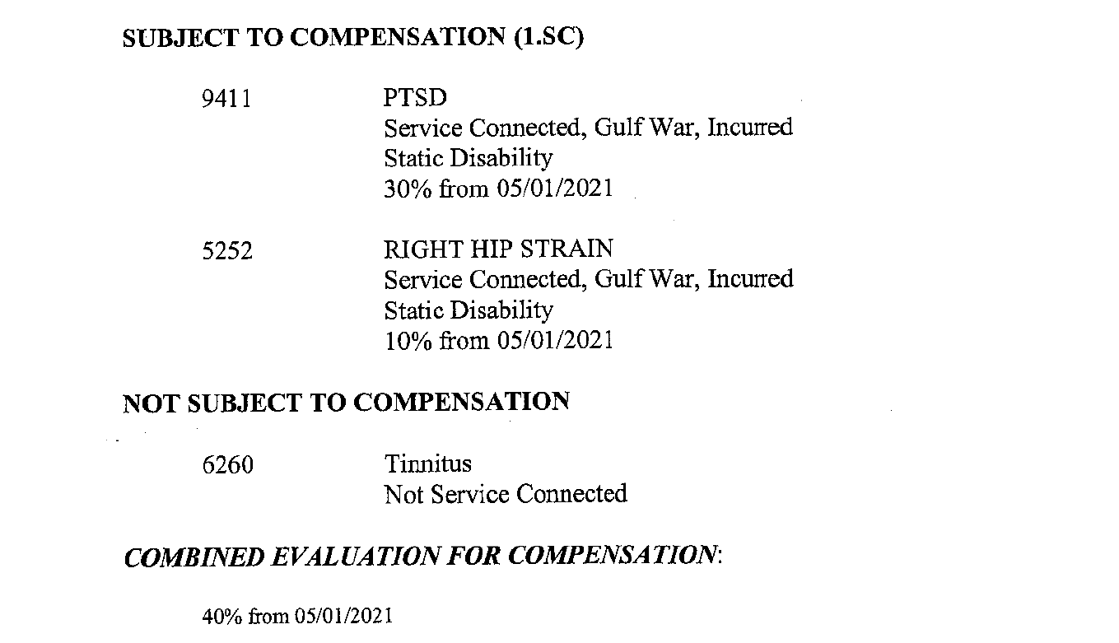
Rating Code Sheet
Notes:
Next it will list those items subject to compensation and those that not subject to compensation.
Lastly, it will list the combined compensation. Remember the VA uses VA math to combine ratings. Either use the VA chart to combine ratings, in the following order: Bilateral ratings first from highest percentage to lowest. Then go to non-bilateral ratings starting from the highest percentage to the lowest.
Or best to use the VA rating calculator on the computer.

Slide 14
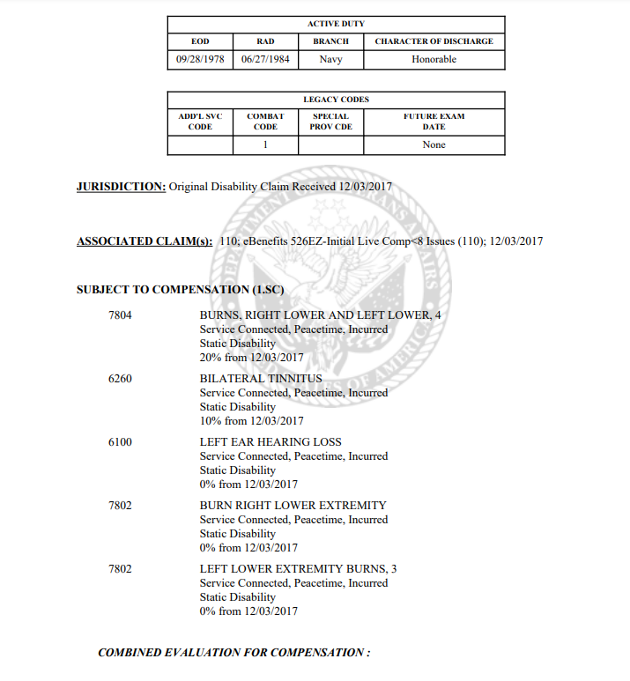
Notes:
Lets take a look at this Code Sheet. When looking at the Subject to Compensation area, is there anything that stands out.
Look at 6260-Bilateral tinnitus, yet 6100 is only listing left ear hearing loss. So what is the next form we want to look at? Answer: The claim that goes with this decision to see what was applied for. Was it only the left ear. In this case, it was not. So what forms do you want to check next. Answer: Rating Narrative and then the C&P Exam.

Slide 15
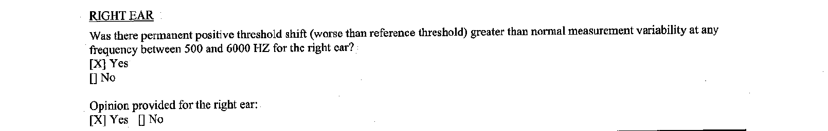
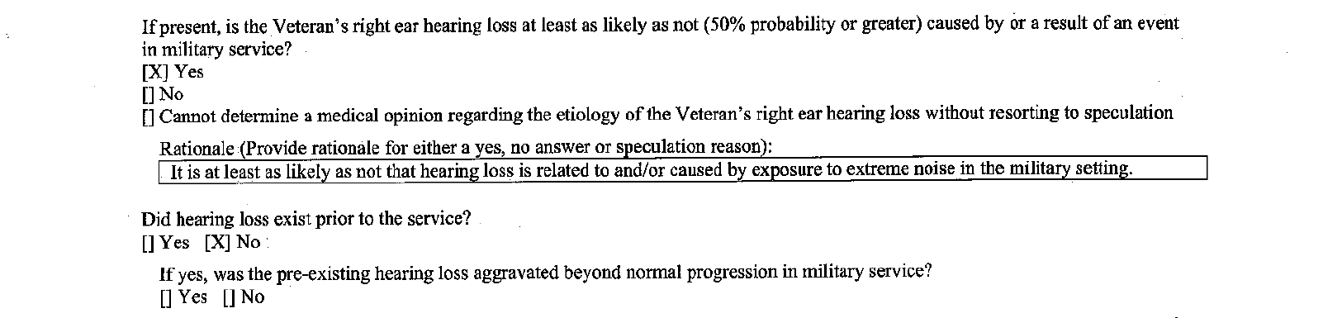
C&P Exam
Notes:
After going through the C&P exam, what do we have? Answer: A Clear and Unmistakable Error.

Slide 16
Effective Dates
SUBJECT TO COMPENSATION (1.SC)
7804 BURNS, RIGHT LOWER AND LEFT LOWER, 4
Service Connected, Peacetime, Incurred
Static Disability
20% from 12/03/2017
6260 BILATERAL TINNITUS
Service Connected, Peacetime, Incurred
Static Disability
10% from 12/03/2017
6100 LEFT EAR HEARING LOSS
Service Connected, Peacetime, Incurred
Static Disability
0% from 12/03/2017
Make sure that the Effective Date matches the ITF date if one was on file at the time of submittal or it matches the date that the claim was submitted if no ITF was on file.

Slide 17
Common Errors
Missed Evidence: Did the VA consider all of the evidence? Did they miss something in the STR, Medical Record, E-Folder etc…
Effective Dates: Did VA apply the correct effective date? Be sure to look for an ITF or other ways that an effective date may be earlier that is on the claim form.
Bilateral Factors: Did the VA apply all of the eligible bilateral factors?
Missed Contentions: Did the VA address all issues?
Notes:
Bullet 2: Ask audience what else can effect the date? Answer ie: Niehmer grant, Clear and Unmistakable Error, missed ITF, multiple claims and they put the wrong date to the wrong claim.
Bullet 3: Bilateral factors can be a whole another class.

Slide 18
Common Errors
Granted Percentage: Use the CFR to determine if the correct rating percentage was applied.
Denial: If the issue was denied, look at the reason and determine if it is a valid reason for denial.
If you discover an error during your review, notify the veteran and discuss possible appeal options. Document everything in the Communication Tab.
Remember: There is a big difference between a factual error and a difference in opinion. Not every denial is an error.

Slide 19
Reviewing a Rating
QUESTIONS/DISCUSSION

